Slide 1
Recommendation of Neighborhoods in Scarborough
Capstone Project final presentation

Slide 2
Objective
The main objective of this project is to recommend a better neighbourhood in a new city of Toronto and will help in exploring the city and get the awareness of the neighbourhoods in the new city

Slide 3
Target Audience
Potential clients look to buy property in Toronto, who have lack of knowledge about the neighbourhoods in the city
People who are interested in investing on Real estate
The business that wants to use the information to enhance the user experience and advertisements

Slide 4
Data
Toronto Neighbourhood data from ‘https://en.wikipedia.org/wiki/List_of_postal_codes_of_Canada:_M’
Foursquare API data to further explore venues
Neighborhood coordinates from Google geocoder API

Slide 5
Methodology
With the available data frame that contains the Neighbourhood data with coordinates, the analysis can be started by plotting a map with the help of the package folium
Then, the Foursquare API is used to get the nearby venues
Find top 5 venues using ‘One hot encoding’ method
Find the right k value using ‘Elbow method using inertia’ method to implement ‘K means clustering’ technique
Cluster neighbourhoods using ‘K means clustering’

Slide 6
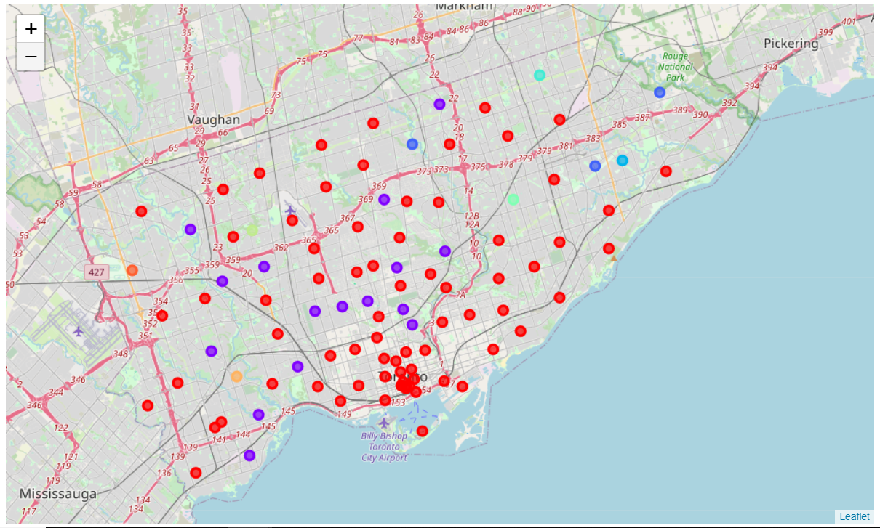
Result

Slide 7
Discussion
The clusters 1 and 2 has a greater number of venues with the Top school rating of more than 5 and Average house price of more than 330000
Cluster 6 has only one venue ( Westmount ), where the Average house price is 165000 (which is lesser than any other venue in other clusters) and Top school rating is 8
For a person, who loves to have food outside most of the time (especially bachelors) and spend time in pub, cluster 1 is the obvious choice. As it has lot of such venues with Restaurant, Pub, Café, Hotel, Bakery and all.
For a person, who often go to recreational sites such as Park, Playground, etc., Cluster 2 is the obvious choice.
For a person who has his family along, will go for the clusters based on their budget. If the budget is low, then ‘Westmount’ will be recommended. Others, it may vary with their needs.

Slide 8
Result
With the help of the clustered data, this project will be helpful in recommending neighbourhoods to consider and explore. The final decision on selecting a neighbourhood will be made by the client based on their budget and primary needs.

